Slide 1
SAE J3068 Meeting
EV Power Transfer using Three-phase Capable Coupler
Rodney McGee
Tuesday, April 18, 2017 .
Noon ET
WebEx Meeting

Slide 2
Transparency Statement
This Task Force is committed to transparency at the highest level.
All topics are discussed in open meetings and decisions are consensus based (not unanimous).
Task Force members are required to be vigilant in their efforts to monitor Task Force activities and decisions by actively participating in the Task Force.
Any issues with the transparency of this Task Force not resolved by the Task Force Chairman should be brought to the attention of the SAE for resolution.

Slide 3
Anti-Trust Statement
In discharging their responsibilities, members of the Technical Standards Board, Councils/Division, and Technical Committees function as individuals and not as agents or representatives of any organization with which they may be associated,
except that government employees participate in accordance with governmental regulations.
Members are appointed to SAE Technical Committees on the basis of their individual qualifications which enable them to contribute to the work of the Committee.

Slide 4
Patent Disclosure
Each SAE Technical Committee or SAE working group member would be required to disclose at specified times during a development process all patents and patent applications that are owned, controlled or licensed by the member, member’s employer or third party and that the member believes may become essential to the draft specification under development.
The member would make this disclosure based on the member’s good faith and reasonable inquiry.
If SAE International receives a notice that a proposed SAE Technical Report may require the use of an invention claimed in a patent, the respective part of the SAE Technical Standards Board Policy will be followed.

Slide 5
Use Discretion in Information Exchange
Members of SAE Technical Standards Boards, Councils and Technical Committees and working groups shall be sensitive to the nature of information they share and exchange when carrying out their responsibilities.
Members are to exercise discretion at all times keeping in mind that a primary objective of their membership is to contribute to the advancement of technical and engineering science through the development of recognized industry reports and standards.
SAE is not responsible for protecting information exchanged by members, nor will SAE be liable for or mediate any dispute related to any misuse of information.

Slide 6
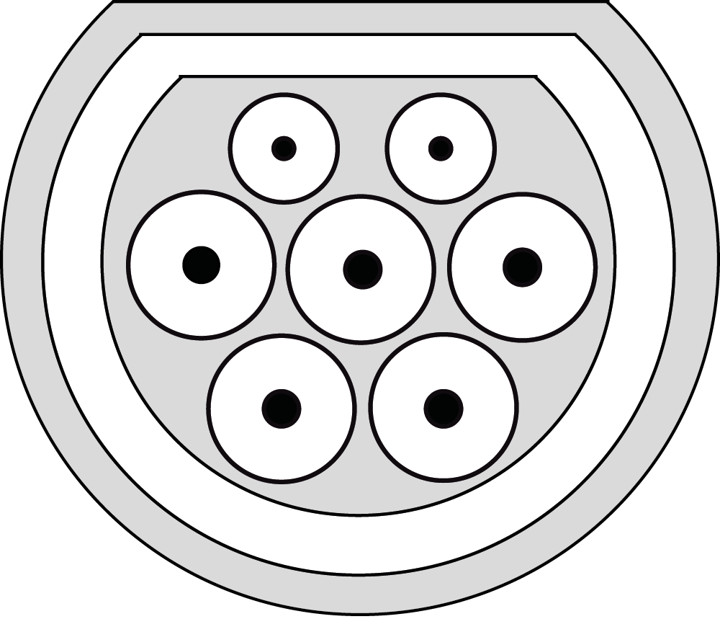
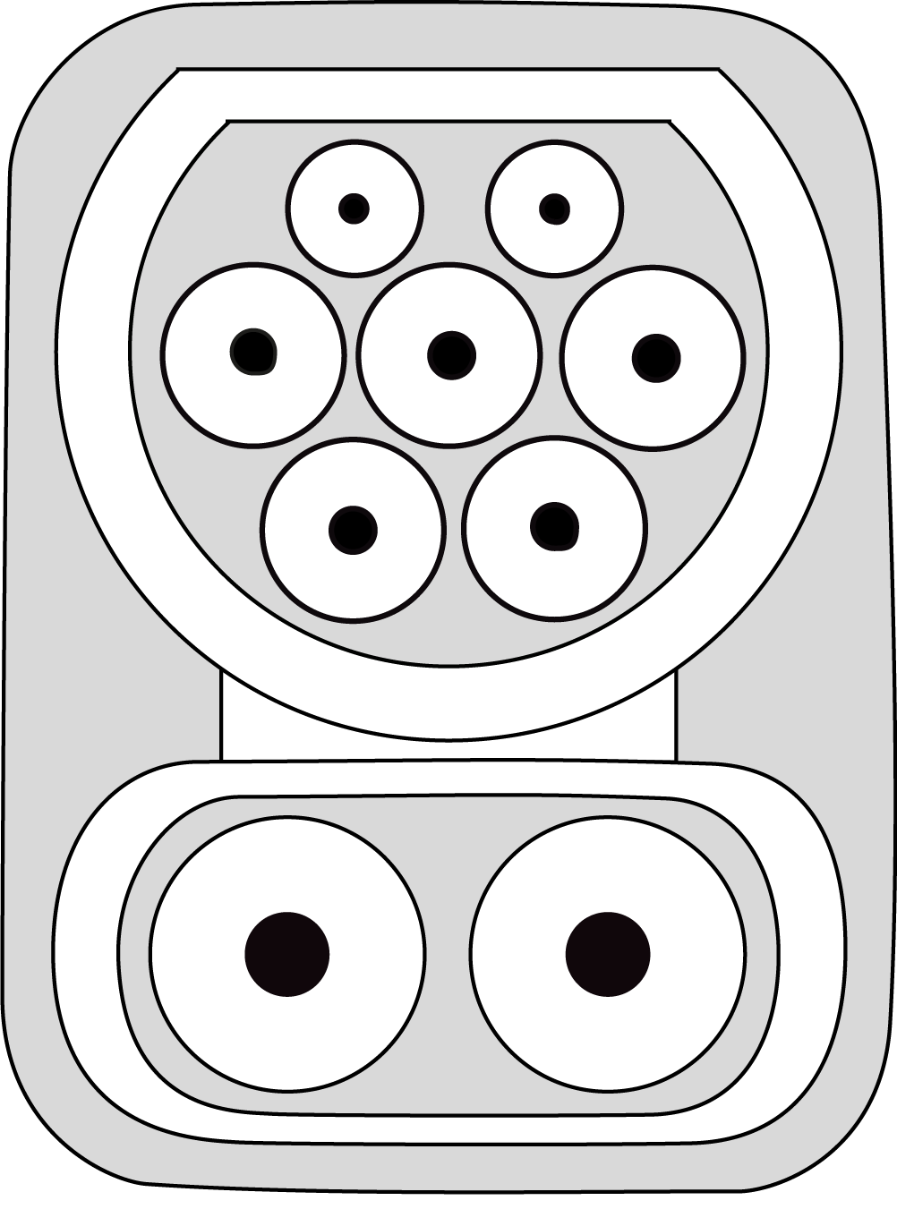
SAE J3068
Inlet Configurations | Description | Utilizable Input Voltages (Not safety rating)
J3068 AC₆ | AC only | VAC_{nom} 208/120Y, 480/277Y, 600/347Y
J3068 AC₆+DC₈ | AC on 6mm pins or DC on 8mm pins | VAC_{nom} 208/120Y, 480/277Y, 600/347Y or VDC 1000

Slide 7
SAE J3068
Go to to Agenda

