Slide 1
SAE J3068 Meeting
EV Power Transfer using Three-phase Capable Coupler
Rodney McGee
Wednesday, May 11, 2016 Noon ET
WebEx Meeting

Slide 2
Transparency Statement
This Task Force is committed to transparency at the highest level.
All topics are discussed in open meetings and decisions are consensus based (not unanimous).
Task Force members are required to be vigilant in their efforts to monitor Task Force activities and decisions by actively participating in the Task Force.
Any issues with the transparency of this Task Force not resolved by the Task Force Chairman should be brought to the attention of the SAE for resolution.

Slide 3
Anti-Trust Statement
In discharging their responsibilities, members of the Technical Standards Board, Councils/Division, and Technical Committees function as individuals and not as agents or representatives of any organization with which they may be associated,
except that government employees participate in accordance with governmental regulations.
Members are appointed to SAE Technical Committees on the basis of their individual qualifications which enable them to contribute to the work of the Committee.

Slide 4
Patent Disclosure
Each SAE Technical Committee or SAE working group member would be required to disclose at specified times during a development process all patents and patent applications that are owned, controlled or licensed by the member, member’s employer or third party and that the member believes may become essential to the draft specification under development.
The member would make this disclosure based on the member’s good faith and reasonable inquiry.
If SAE International receives a notice that a proposed SAE Technical Report may require the use of an invention claimed in a patent, the respective part of the SAE Technical Standards Board Policy will be followed.

Slide 5
Use Discretion in Information Exchange
Members of SAE Technical Standards Boards, Councils and Technical Committees and working groups shall be sensitive to the nature of information they share and exchange when carrying out their responsibilities.
Members are to exercise discretion at all times keeping in mind that a primary objective of their membership is to contribute to the advancement of technical and engineering science through the development of recognized industry reports and standards.
SAE is not responsible for protecting information exchanged by members, nor will SAE be liable for or mediate any dispute related to any misuse of information.

Slide 6
Attendance and Minutes Review
Goto Microsoft Word Document
For previous meeting

Slide 7
SAE Structure (part of it)
Hybrid - EV Committee (TEVHYB)
Neil Johnson(chair)
…
Hybrid J1772 Connector Task Force (TEVHYB3) John Halliwell (chair)
Hybrid Communication and Interoperability Task Force (TEVHYB6) Rich Scholer (chair)
Medium and Heavy Duty Vehicle Conductive Charging Task Force (TEVHYB13) Rodney McGee(chair)
…
…
J1772
J2931, J2953, J2847,
J2836, J2954, …
J3068 – Handheld plugin (Jim Mc.)
J3105 – Overhead automated (Mark Ko.)
…
…
…

Slide 8
Scope of J3068
The SAE has authorized a document for three-phase AC charging for electric vehicles
Scope
This document covers the general physical, electrical, functional, testing, and performance requirements for conductive power transfer to an electric vehicle using a coupler capable of, but not limited to, transferring three-phase AC power. It defines a conductive power transfer method including the digital communication system. It also covers the functional and dimensional requirements for the vehicle inlet, supply equipment outlet, and mating housings and contacts.
Targeted towards charging at commercial and industrial locations or other places where three-phase power is available and preferred.

Slide 9
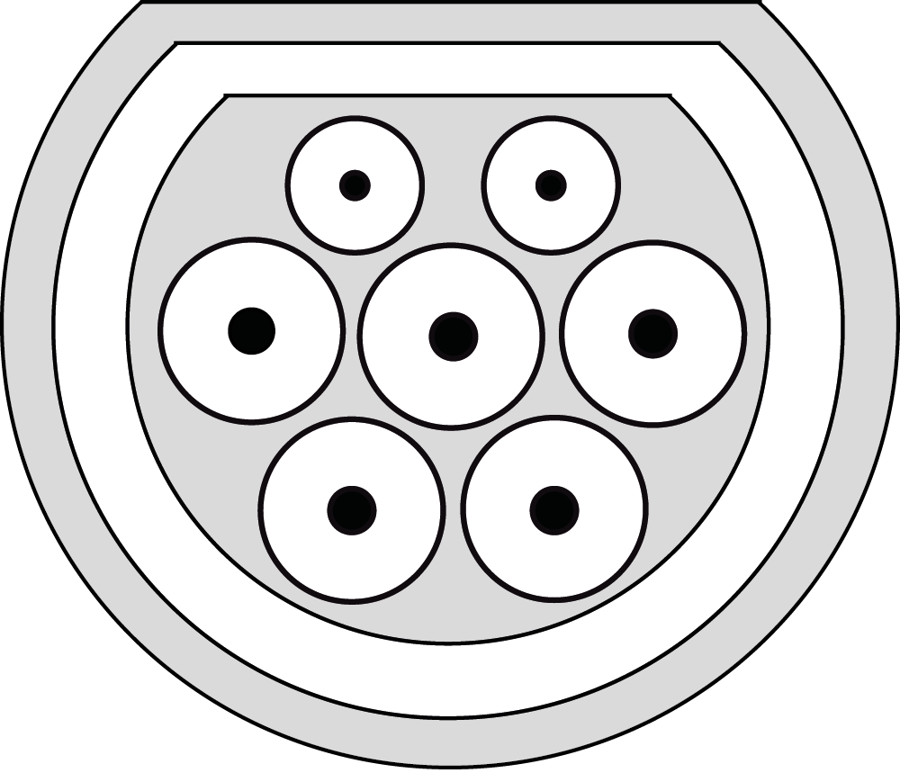
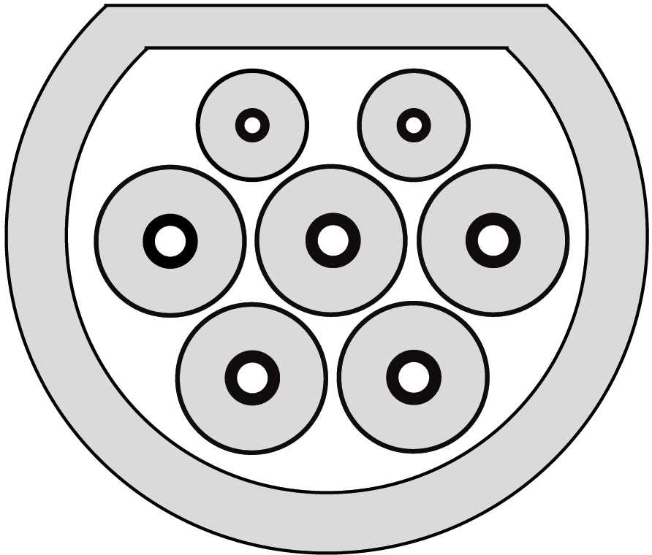
J3068 – Inlet and Connector
Illustration of Vehicle Inlet
Illustration of Vehicle Connector
For mechanical see IEC 62196-2 Sheet 2-IIf
For mechanical see IEC 62196-2 Sheet 2-IIe
Specifications
Note: These specifications are exceptions to the ones defined in IEC 62196-2 for the following countries: US, MX, CA.
Nominal voltages up to 600 V AC three-phase
Current not exceeding 160 A AC three-phase
Must comply with UL 2251
For illustration purpose only (not drawn to scale) – licenses are Public Domain (source Michelle Pettinella)

Slide 10
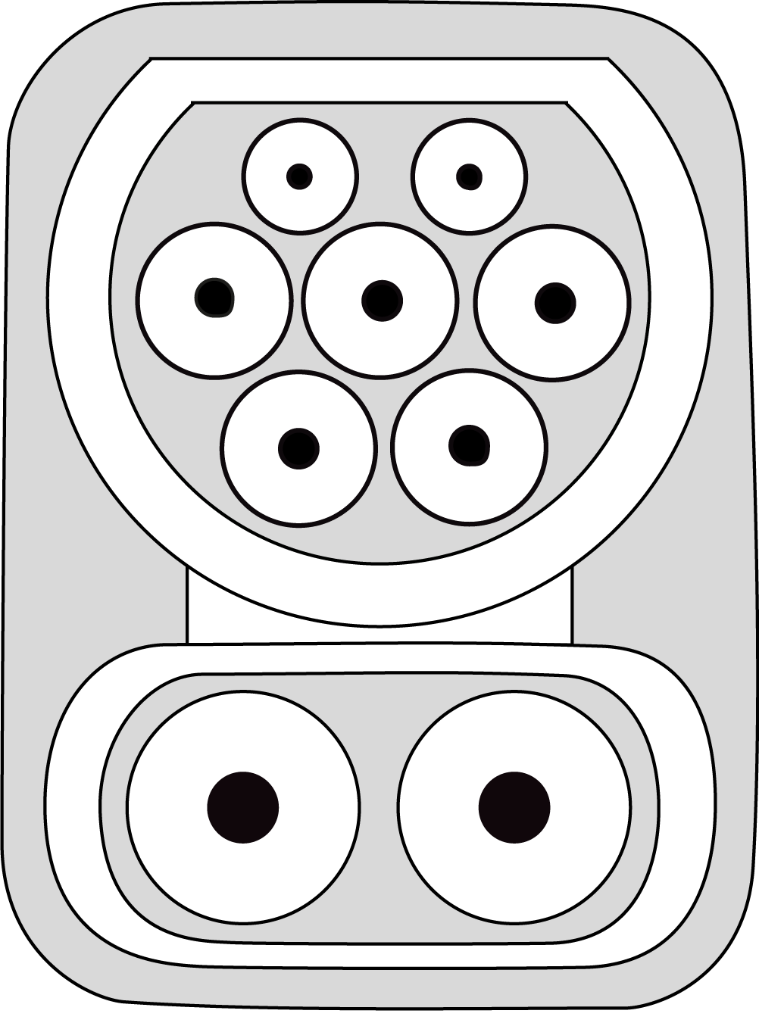
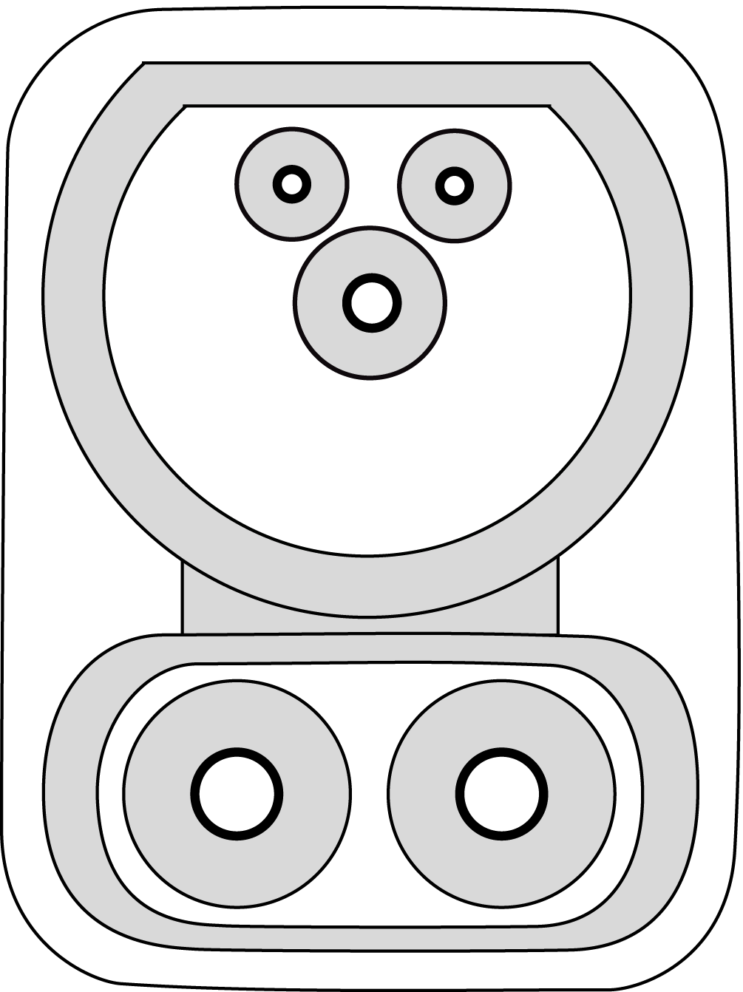
J3068 – Combo Inlet and Connector
Illustration of Vehicle Inlet
For mechanical see IEC 62196-3 Sheet 3-IVa
Illustration of Vehicle Connector
For mechanical see IEC 62196-3 Sheet 3-IVc
Specifications (DC)
Voltages up to 1000 V DC
Current not exceeding XXX A
For illustration purpose only (not drawn to scale) – licenses are Public Domain (source Michelle Pettinella)

Slide 11
J3068 – Combo Inlet
Three-phase AC (6mm pins)
Single-phase also allowed (including 277 VAC)
Can DC charge using SAE CCS communication standards
Uncommon for North American passenger cars
”Type 2 Combo”
Single-phase AC (3.6mm pins)
DC charge using SAE CCS communication standards
Used on several North American passenger cars with infrastructure installed in many locations
Limited AC power; no three-phase; no mandatory AC lock
J1772 CCS / ”Type 1 Combo”

Slide 12
J3068 Draft Document Review
Goto PDF Document that Lennart Balgard and Jim McLaughlin prepared and posted in work area

