Slide 1
SAE J3068 Meeting
EV Power Transfer using Three-phase Capable Coupler
Rodney McGee
Thursday, October 16, 2014 11:30AM EDT
WebEx Meeting

Slide 2
Agenda Review
1. Welcome and Introductions
1.1. SAE Anti-Trust Statement
1.2. SAE Patent Disclosure
1.3. Committee Procedures and Member Participation
2. Review of the Minutes from June 26, 2014 Meeting.
3. Membership Review
Liaison Activities
Document(s) in Need of Five-Year Review
Old Business
7. New Business
7.1 Update on the state of the document writing
7.2 Update on request to build and list systems and components
7.3 Update on related standards and efforts
Next Meeting

Slide 3
Transparency Statement
This Task Force is committed to transparency at the highest level.
All topics are discussed in open meetings and decisions are consensus based (not unanimous).
Task Force members are required to be vigilant in their efforts to monitor Task Force activities and decisions by actively participating in the Task Force.
Any issues with the transparency of this Task Force not resolved by the Task Force Chairman should be brought to the attention of the SAE for resolution.

Slide 4
Anti-Trust Statement
In discharging their responsibilities, members of the Technical Standards Board, Councils/Division, and Technical Committees function as individuals and not as agents or representatives of any organization with which they may be associated,
except that government employees participate in accordance with governmental regulations.
Members are appointed to SAE Technical Committees on the basis of their individual qualifications which enable them to contribute to the work of the Committee.

Slide 5
Patent Disclosure
Each SAE Technical Committee or SAE working group member would be required to disclose at specified times during a development process all patents and patent applications that are owned, controlled or licensed by the member, member’s employer or third party and that the member believes may become essential to the draft specification under development.
The member would make this disclosure based on the member’s good faith and reasonable inquiry.
If SAE International receives a notice that a proposed SAE Technical Report may require the use of an invention claimed in a patent, the respective part of the SAE Technical Standards Board Policy will be followed.

Slide 6
Use Discretion in Information Exchange
Members of SAE Technical Standards Boards, Councils and Technical Committees and working groups shall be sensitive to the nature of information they share and exchange when carrying out their responsibilities.
Members are to exercise discretion at all times keeping in mind that a primary objective of their membership is to contribute to the advancement of technical and engineering science through the development of recognized industry reports and standards.
SAE is not responsible for protecting information exchanged by members, nor will SAE be liable for or mediate any dispute related to any misuse of information.

Slide 7
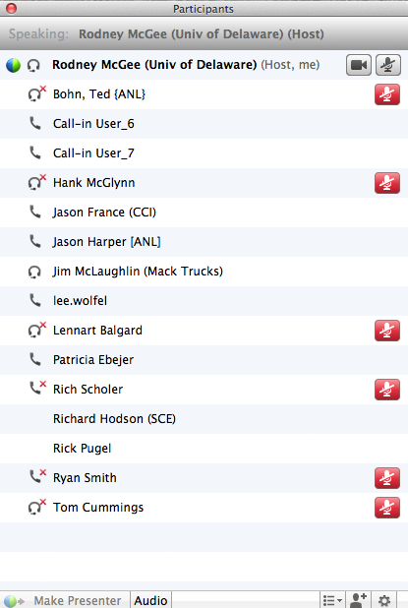
Minutes Review – Attendance
Paste attendance

Slide 8
Minutes Review – Minutes
2014-06-26 Meeting Minutes
6. New business
6.1 Reviewed current state of three-phase and available building block for new standards
6.2 Basic proposal for three-phase charging system including coupler and communication requirements with wide consensus
6.3 Request to start an effort to list components and supply equipment to a forthcoming draft standard

Slide 9
Scope of J3068
The SAE has authorized a document for three-phase AC charging for electric vehicles
Scope
This document covers the general physical, electrical, functional, testing, and performance requirements for conductive power transfer to an electric vehicle using a coupler capable of, but not limited to, transferring three-phase AC power. It defines a conductive power transfer method including the digital communication system. It also covers the functional and dimensional requirements for the vehicle inlet, supply equipment outlet, and mating housings and contacts.
Targeted towards charging at commercial and industrial locations or other places where three-phase power is available and preferred.

Slide 10
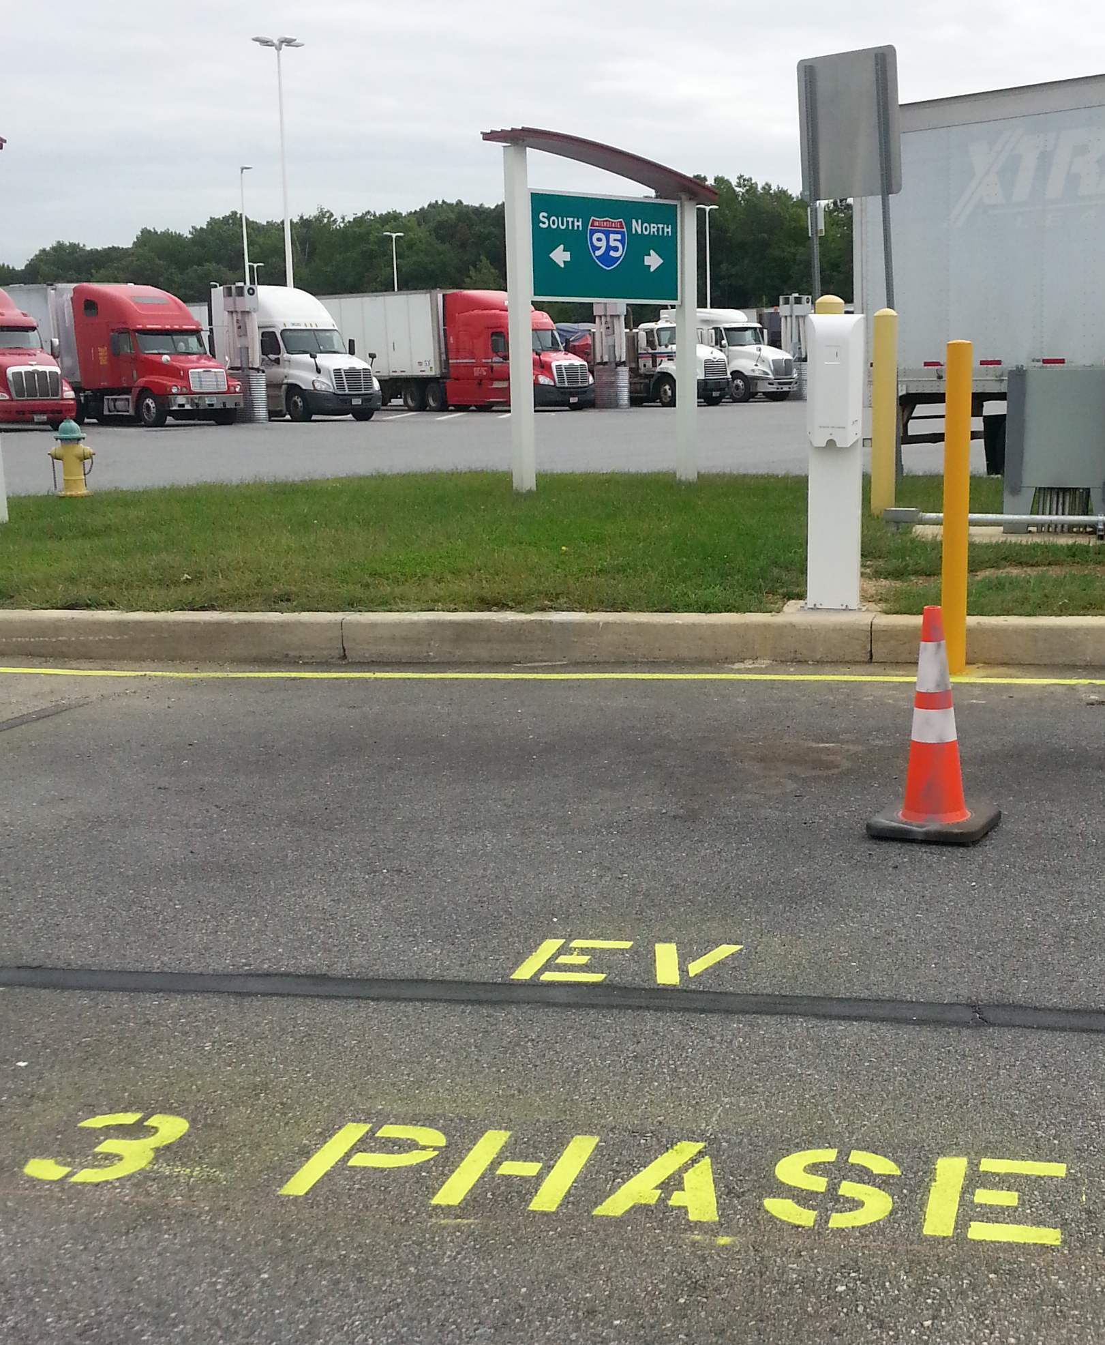
Charging stations on the way
In-progress installation of 480VAC 100A charging station located at the Delaware I-95 rest stop truck area
Using funding from the State of Delaware
Located near mid-point between DC and New York.

Slide 11
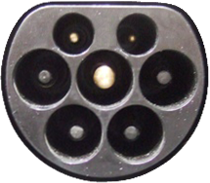
Progress on UL-listed version Type 2
Existing physical dimensions specified in IEC 62196-2
Standard for Safety UL 2251 Plugs, Receptacles, and Couplers for Electric Vehicles
Several manufacturers have successfully completed some internal testing
Testing at voltages covered by J3068
Testing at higher currents allowed by J3068
Type-2 Inlet
L1,L2,L3,N,GND,CP,PP

Slide 12
Document Writing Underway
Some basic references and verbiage
Power and voltage levels
Control Pilot functions
Verification of equipment grounding continuity
EVSE current capacity
VAC compatibility check
Etc..
Proximity
New coding for Case C (EVSE fixed cord set)
References
IEC 62196-2 “Type 2”
Include recent requirement for AC vs. AC/DC keying
IEC 61851-1 Annex D “CAN-CP”

Slide 13
Backup

Slide 14
IEC 62196 Proximity Current Coding
Rc | Continuous amp rating cord limit | Breaker NEC
1.5kΩ | 13A | 15A (12A PWM)
680Ω | 20A | 25A
220Ω | 32A | 40A
100Ω | 63A | 80A
56Ω* | Limit set by Control Pilot for permanently attached cordsets | As required by EVSE
33Ω* | Interrupt power flow (EV) | -
Remember the nominal charging current limit is as interpreted by the EV defined as the minimum of EVSE supply limit (from the control pilot) and cordset limit (from plug proximity).
*To be defined in J3068

